Slide 1
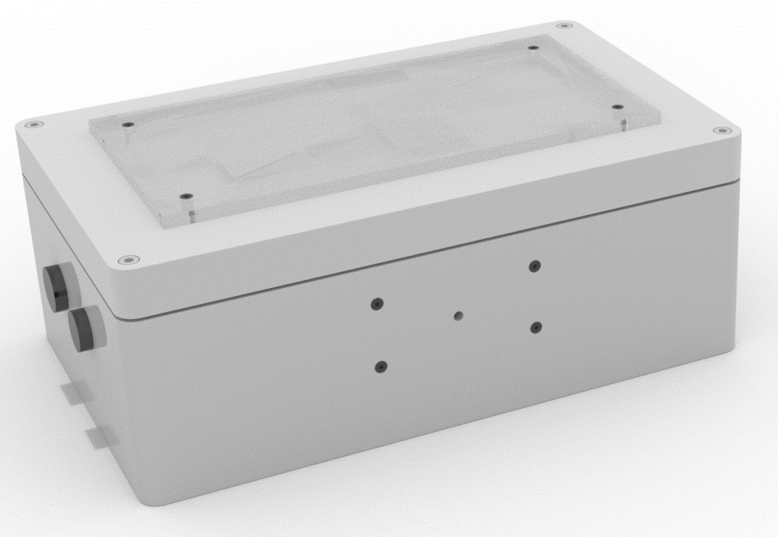
Moodlight More than just a lamp
I. Krajinovic, L. Müggler
15.06.2020

Slide 2



Why buy the Moodlight?

Slide 3
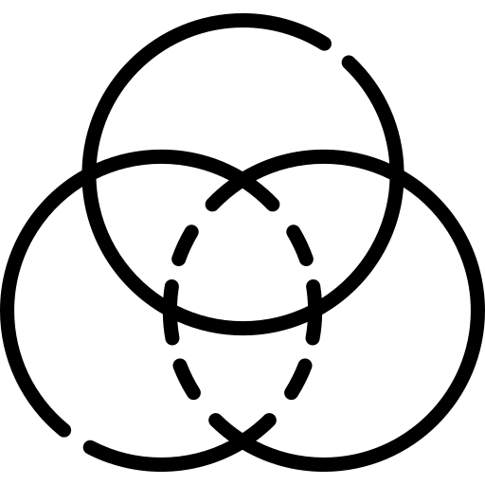
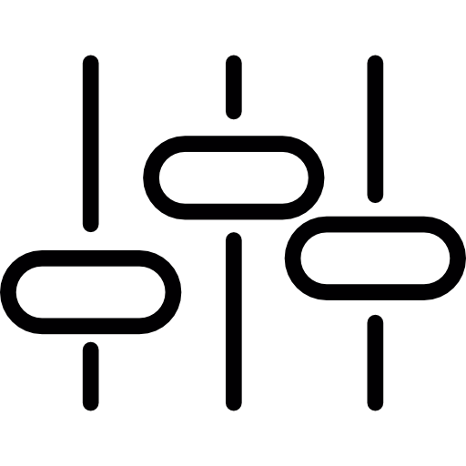
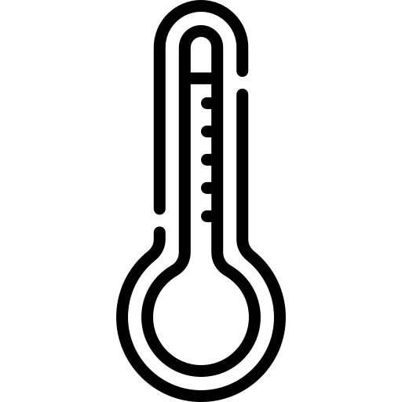
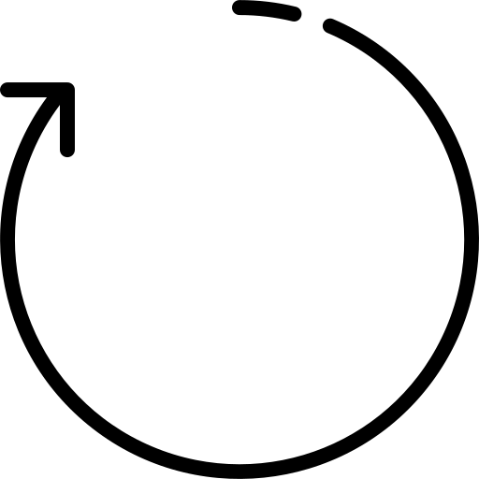
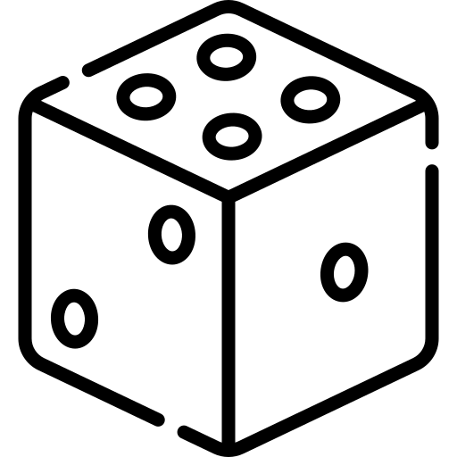
Modes

Slide 4
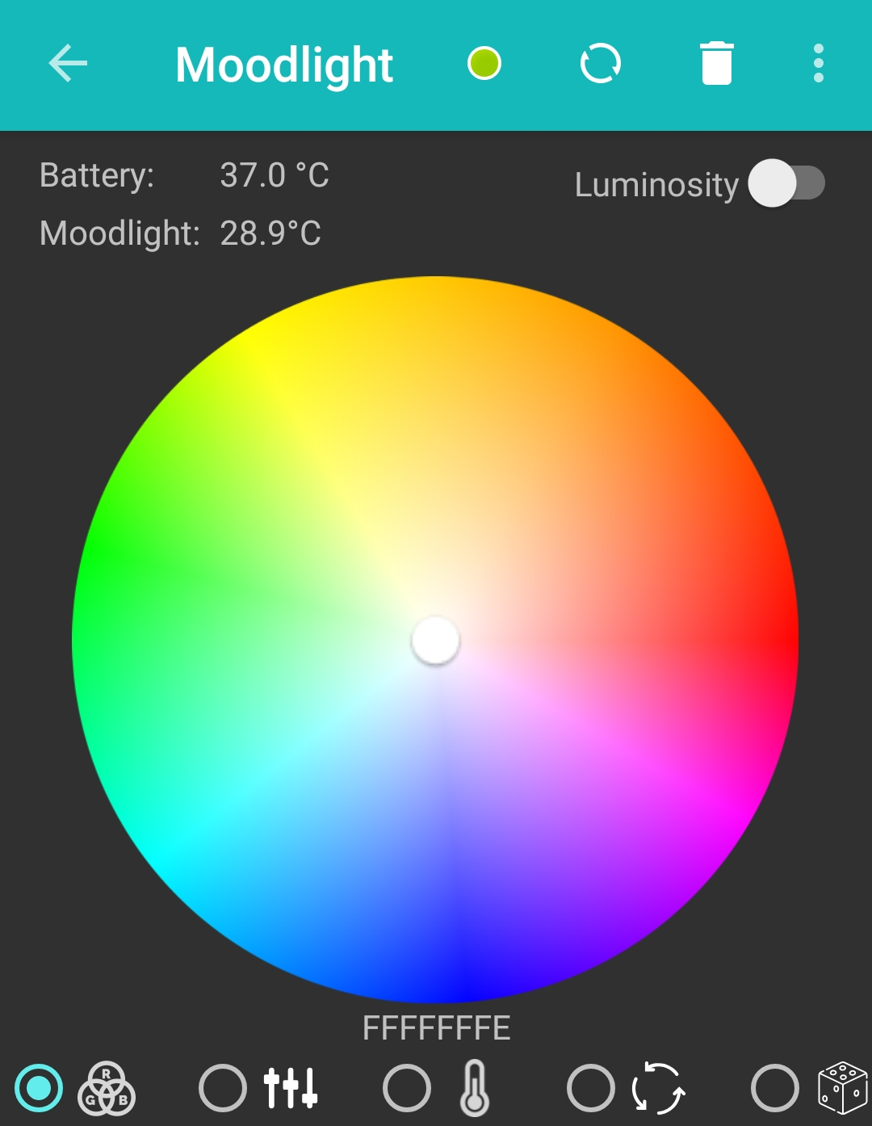
Mode: Colour Circle

Slide 5
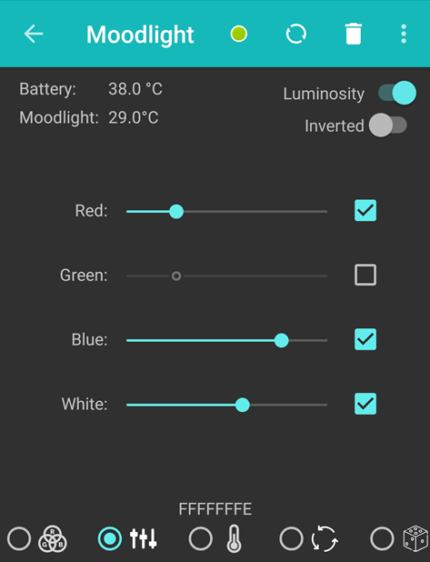
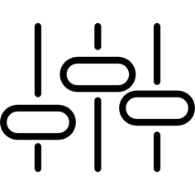
Mode: Slider

Slide 6
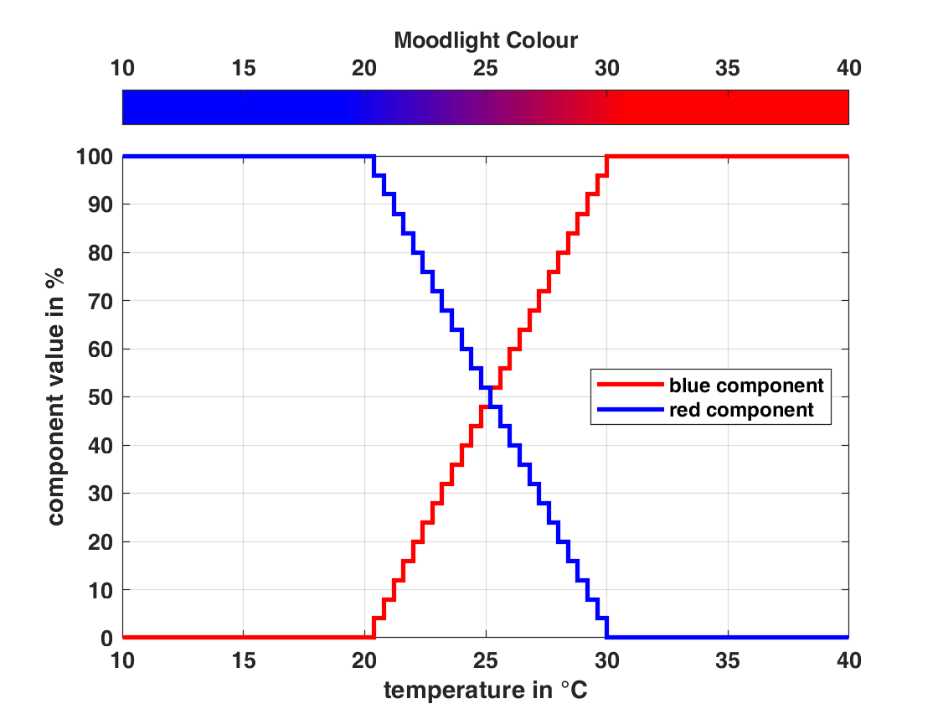
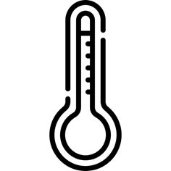
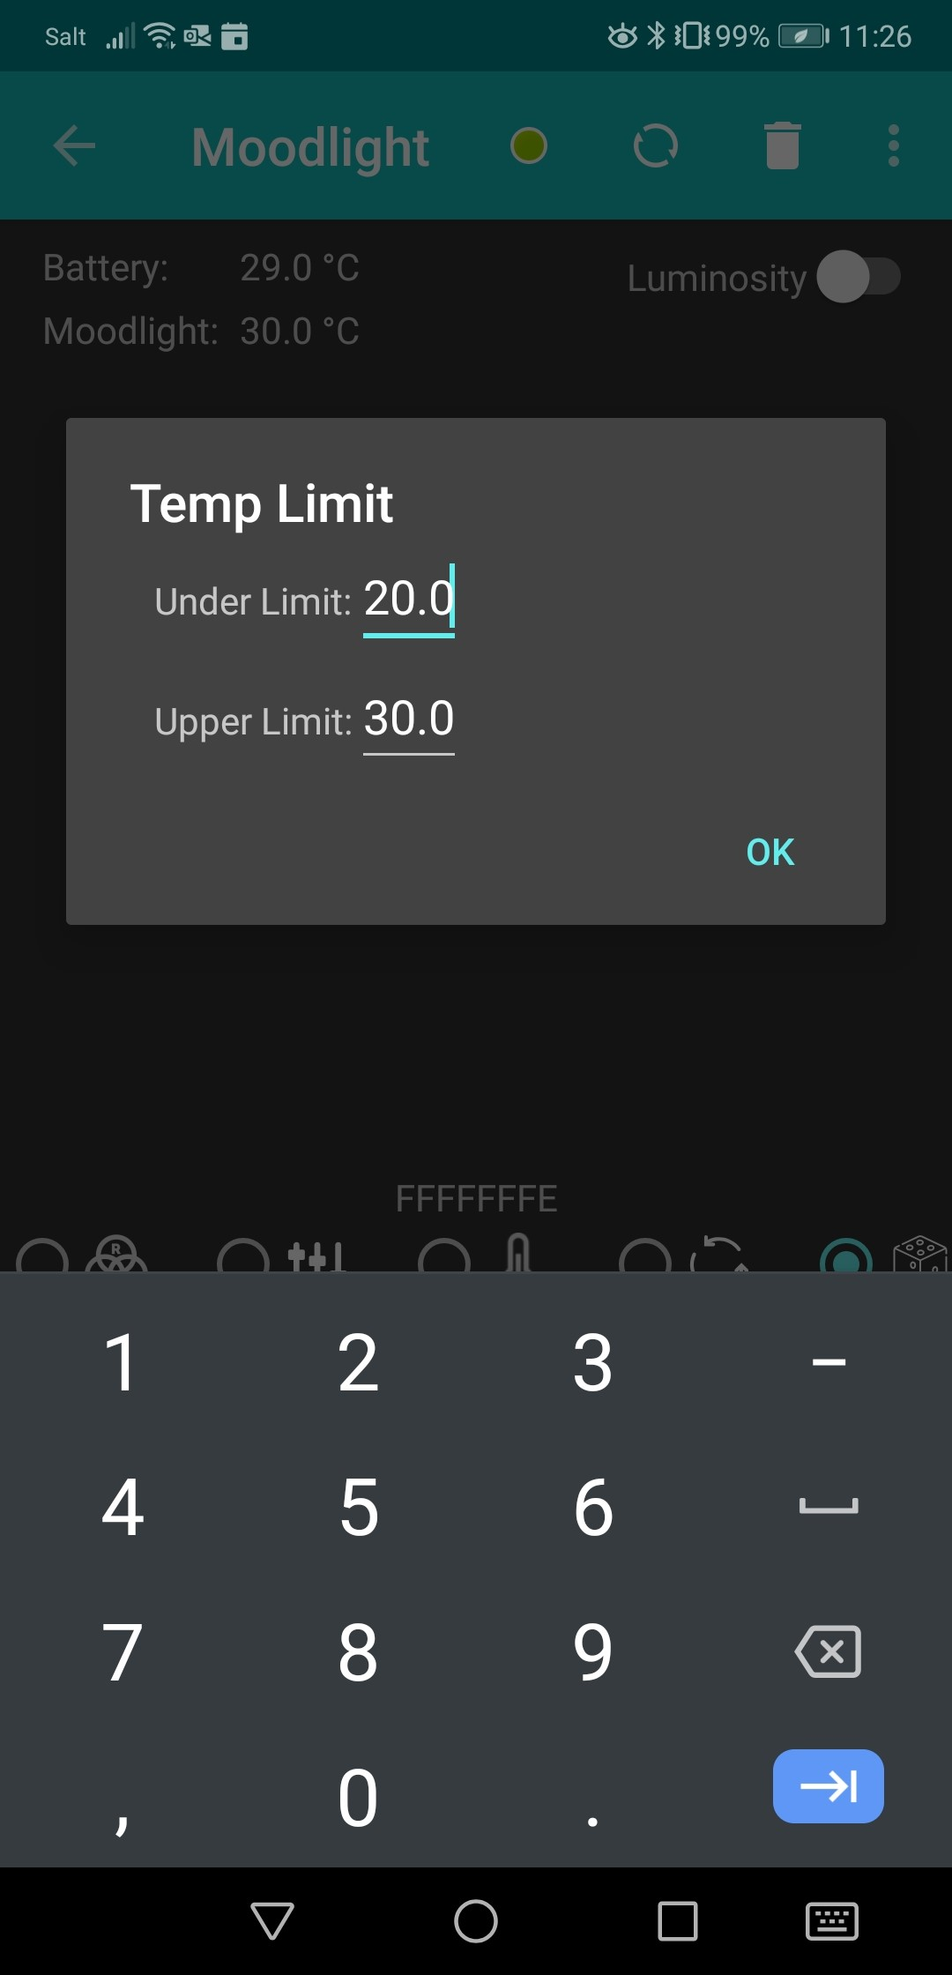
Mode: Temperature

Slide 7
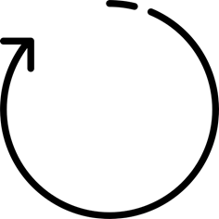
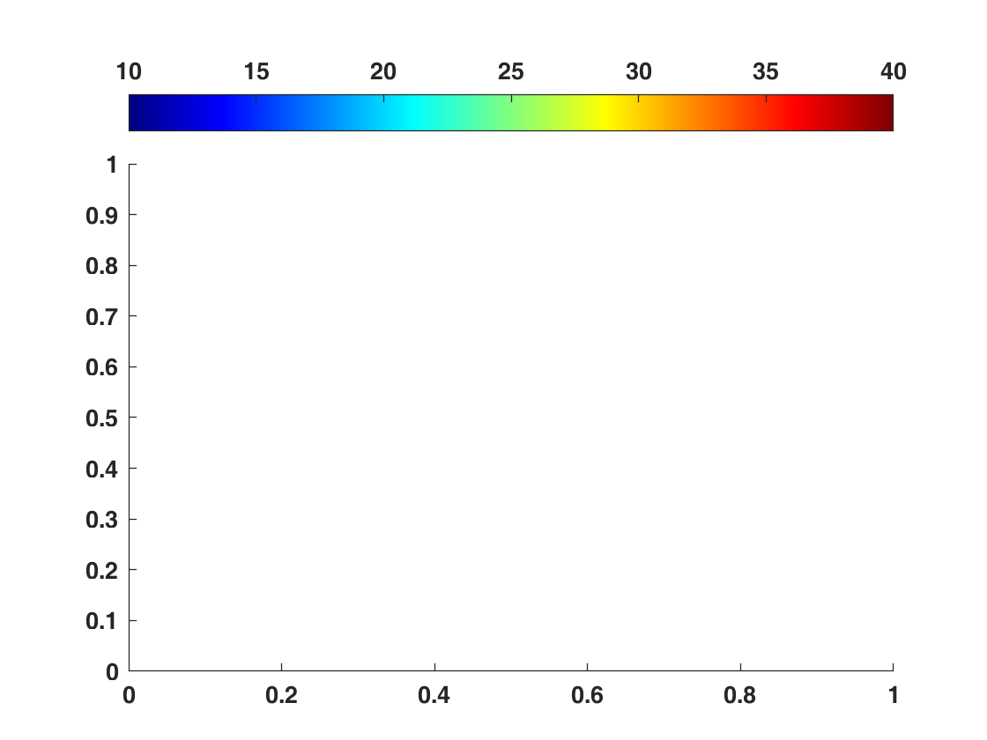
Mode: Fade

Slide 8
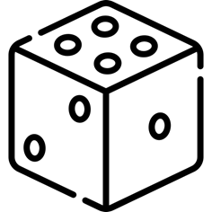
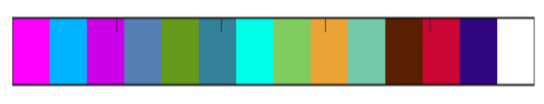
Mode: Random

Slide 9




Adaptive Brightness
1.
2.

Slide 10





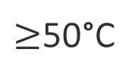
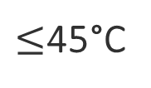
Security Feature
$≥$50°C
$≤$45°C

Slide 11
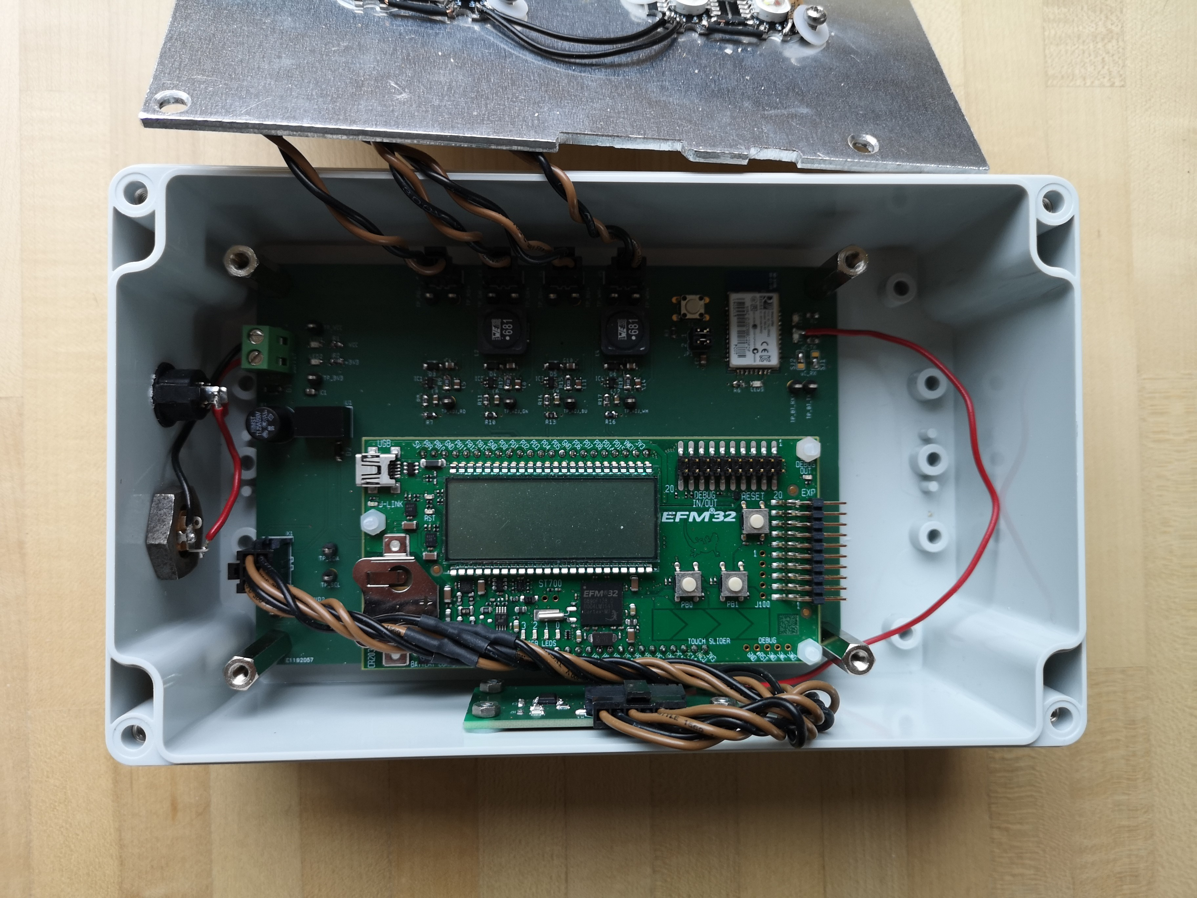
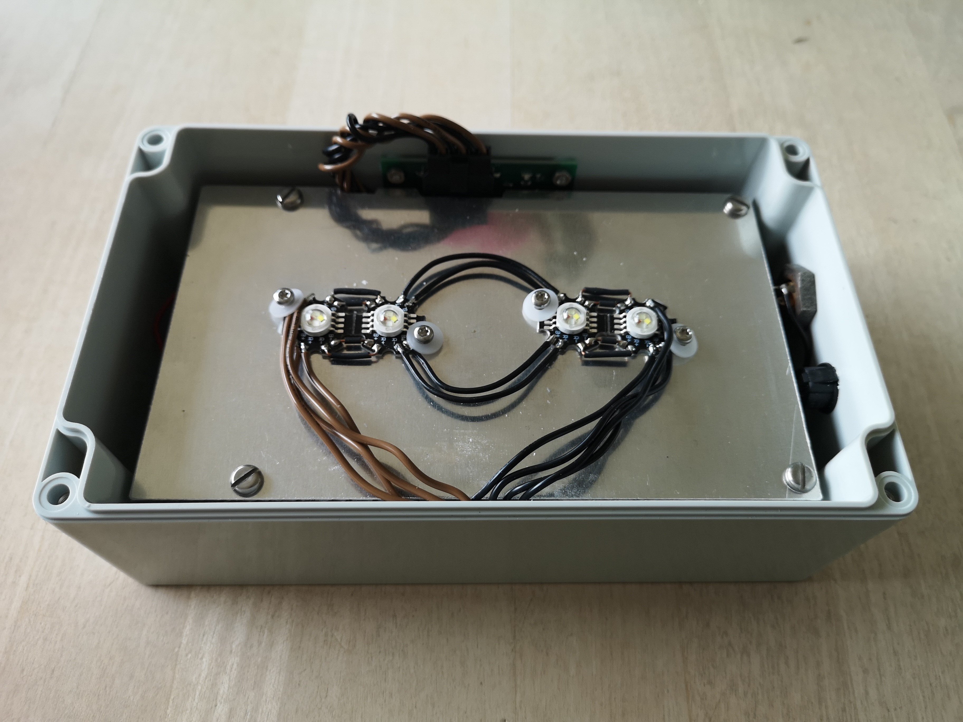
Additional Specifications
Bluetooth Range up to 10 m
Continuous operation possible (up to 32°C)
Layer construction
Easy assembly/dissassembly
Case is of plastic (ABS)

Slide 12
Cost
custom-made item
Mass Production
µC Module 100 CHF
Casing 40 CHF
Electronics 75 CHF
PCB 30 CHF
Total 245 CHF
µC Module 15 CHF
Casing 30 CHF
Electronics 60 CHF
PCB 10 CHF
Total 115 CHF

Slide 13
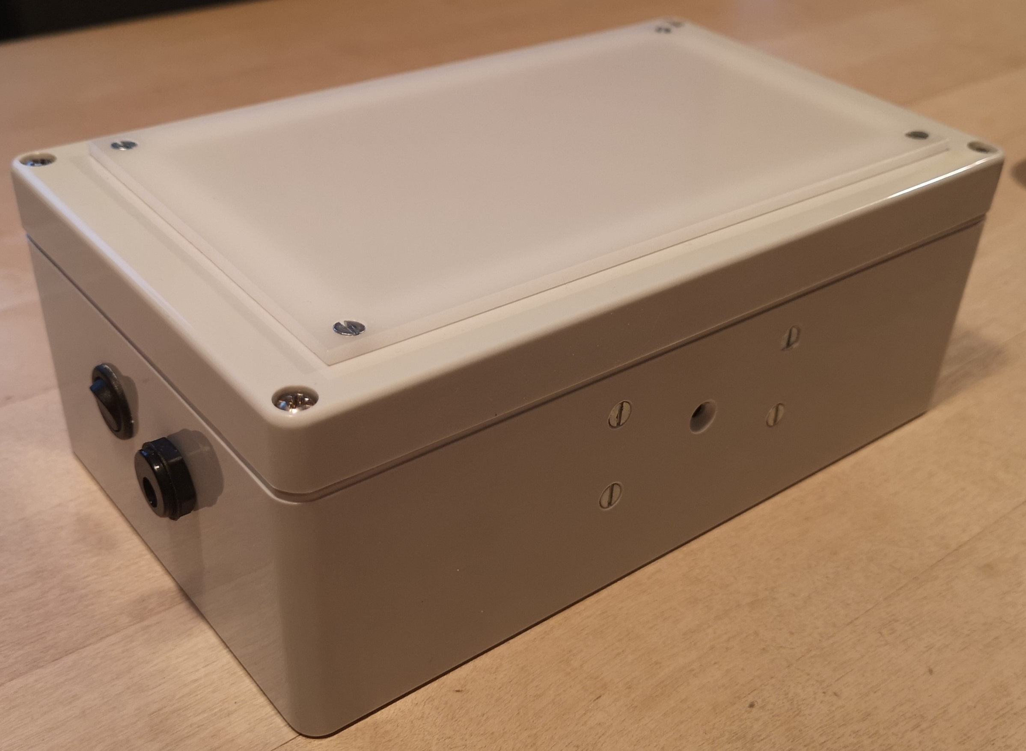
Demonstration

Slide 14
Questions?
Thanks for your attention!

